Slide 1


Slide 2
Introduction
This is a study that is meant to show a clear illustration of how the criminal justice system has treated black women in society whenever they find themselves in the hands of law enforcers.
The theory and practice of how punishment is supposed to be practiced focus entirely on the punishment of the law offenders
Notes:
According to Agozino (2018), unfortunately, not everyone who is punished is an offender. A review was done about the theory and philosophy and theory of punishment that revealed that punishment of someone innocent is considered a logical impossibility since punishment is conventionally interpreted to presuppose an offense.
This dissertation argues that the innocent are punished by mistake and by an intrinsic feature of the adversarial nature of criminal justice Agozino (, 2018). Criminal justice assumes formal equality between substantively unequal parties in class, race, and gender relations.

Slide 3
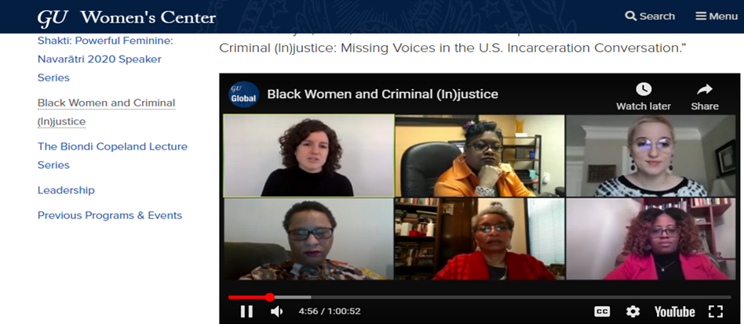
Notes:
The above picture shows a public dialogue that involved panelists, among them black ladies, which took place in June 2020 after the killing of George Floyd alongside countless other black people
Issues discussed include; how the country got to the then-current status quo regarding the criminal justice system's treatment of Black women and women of color, reasons why the voices and experiences of black women were ignored in criminal justice conversations, the moral and human costs of failing to listen to the voices of Black women in the country

Slide 4
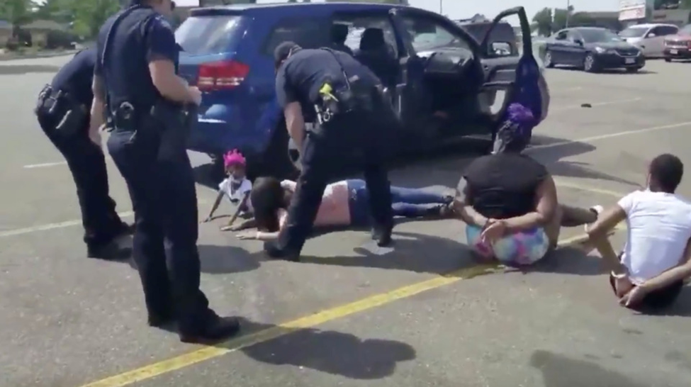
Notes:
A black family of a lady and her children arrested and held at gunpoint by police officers who had wrongfully thought they were driving a stolen car. The most disturbing bit of the incident was that they were six-year-old and were handcuffed facing down.
A survey was carried out and gathered Informal interviews from 20 inmates who happened to be black and was all female. At the same time also an analysis was done about their background information. Agozino (2018) records that during this survey, they found out that black women do commit crimes. Still, unfortunately, racism has a significant influence on the extent to which black women are stopped, searched, cautioned, charged, prosecuted, held in custody, or taken to mental hospitals. Further efforts are needed to combat racism and discrimination despite all the extensive initiatives in government agencies and the criminal justice system.

Slide 5
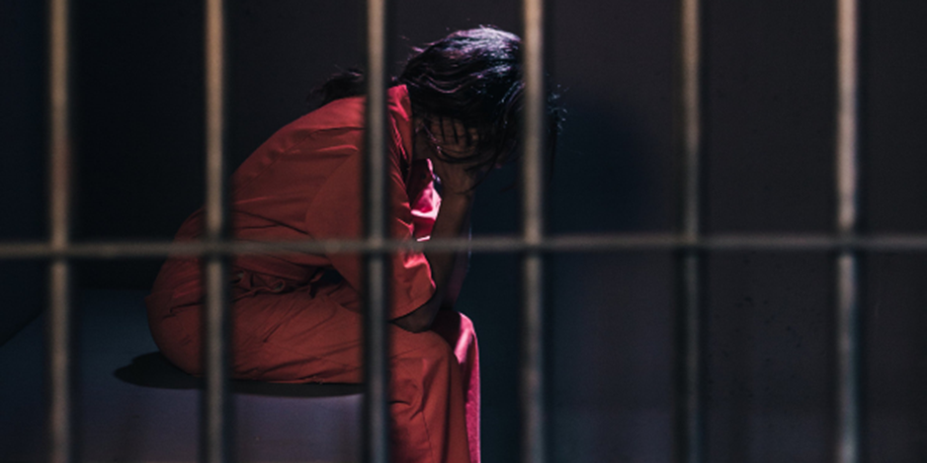
Notes:
The image above is a picture used to tell Lisa Montgomery, who was executed on 13 January 2021 at a federal facility in Terre Haute, Indiana, United States.
She was a victim of many vices, including incest, sexual assault, and abuse from her childhood life which went on into her adult life; the United States government executed her by lethal injection.
All through Lisa Montgomery’s life, the United States Government had failed to protect her from the cumulative, severe child abuse and sexual violence she had gone through.
her male attorneys appeared seemingly uninformed about how she endured the pain and agony of gender violence where she was unable to present a comprehensive picture of the decades of torture and abuse she went through to the jury in her 2007 capital trial when she was sentenced to death.

Slide 6
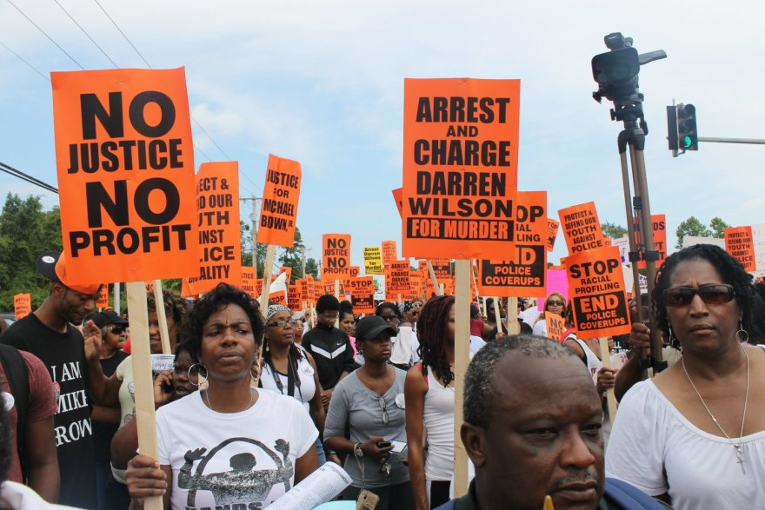
How to Reform the Criminal Justice System and Improve Police-Community Relations
Notes:
Increase the use of special prosecutors in police misconduct investigations
Enhance the collection of data on fatalities involving police
Implement implicit bias training for all federal law-enforcement officers and state and local police involved in federal task forces
Increase the federal government’s oversight of police conduct

Slide 7
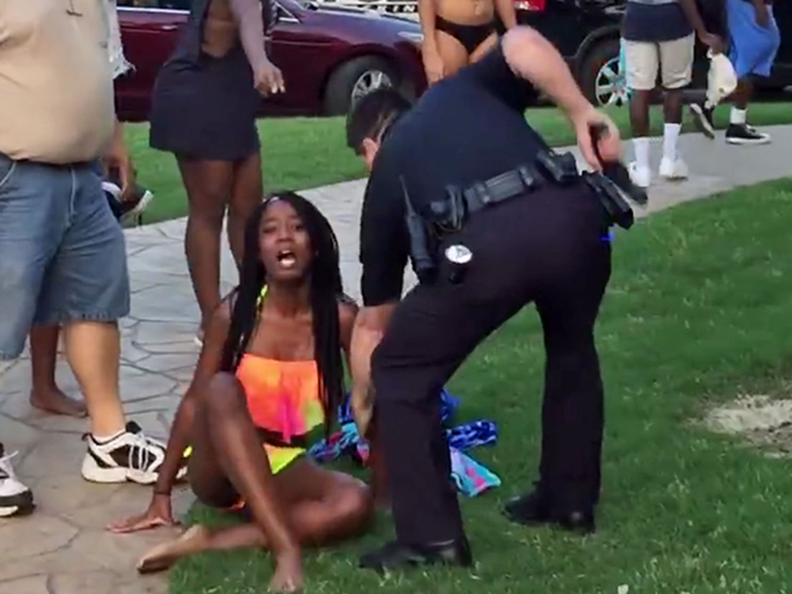
Notes:
Young black girls from the lower economic class may find themselves in trouble. This is especially when they are involved in criminal behavior. This may be viewed as active resistance to victimization, as illustrated in the picture below.
Some of these characteristics may include running away from home, leaving school, or even stealing.
Generally, young girls who engage in such behavior normally find themselves in serious trouble, and they pay a tremendous price for resisting. Such a price is exacted upon them by the criminal justice system, sometimes in conjunction with their parents or even guardians.

Slide 8
References
Agozino, B. (2018). Black women and the criminal justice system: Towards the decolonisation of victimization. Routledge.
Musto, J. (2019). Transing critical criminology: A critical unsettling and transformative anti-carceral feminist reframing. Critical Criminology, 27(1), 37-54.

